Slide 1
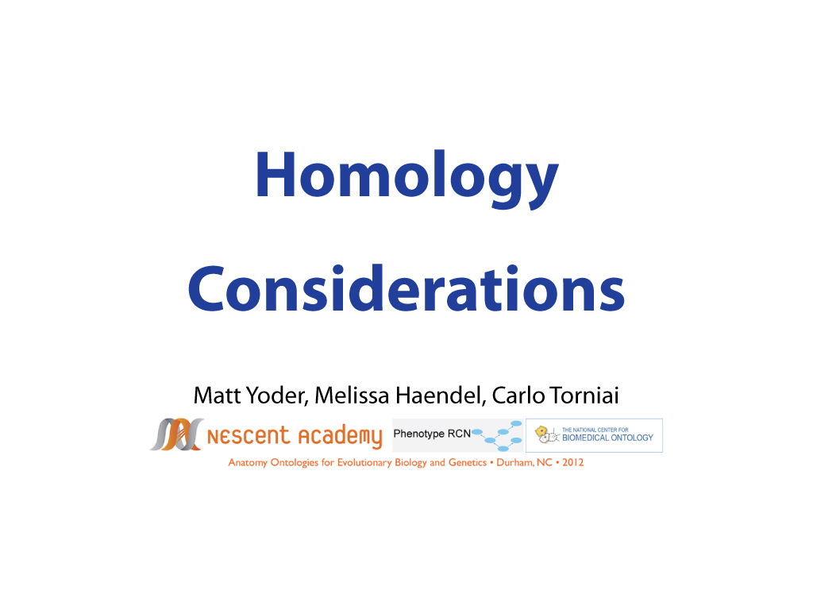

Slide 2
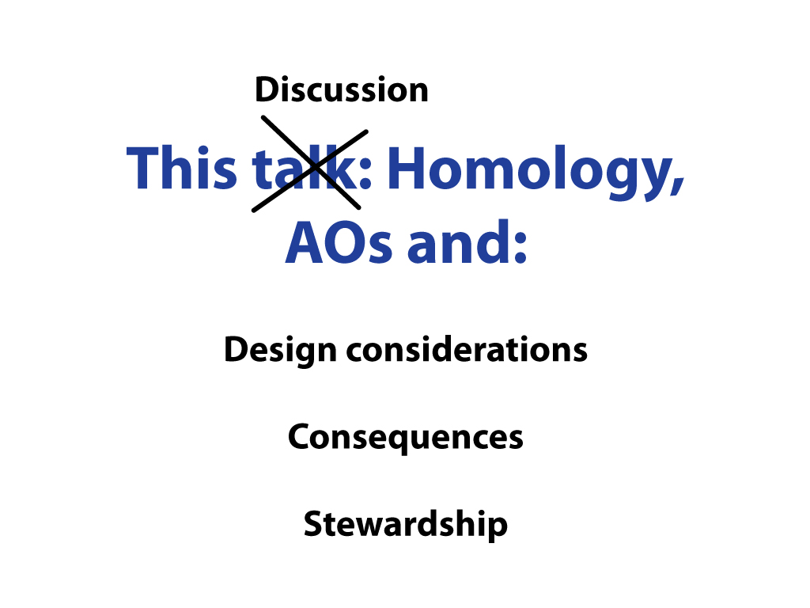

Slide 3
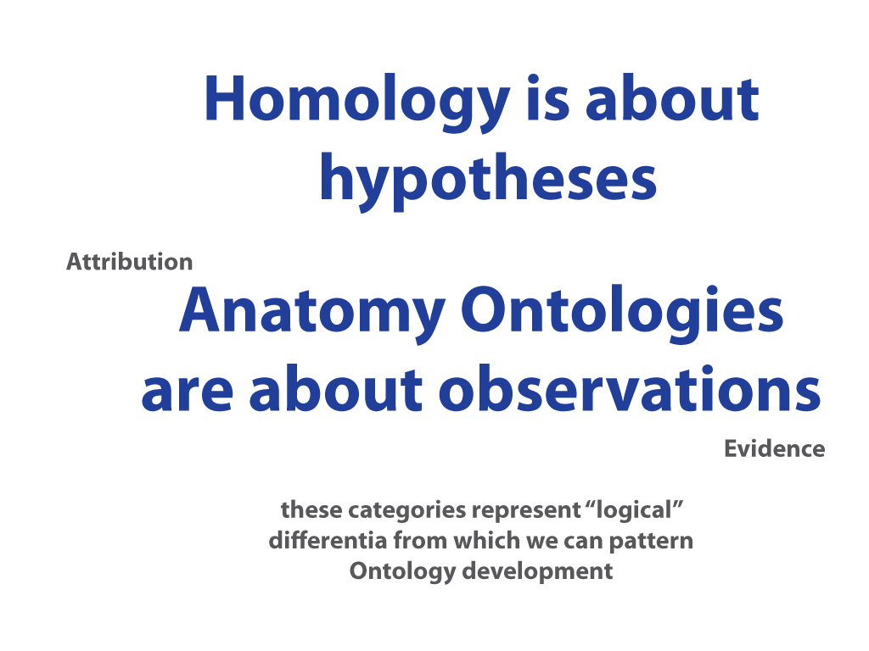

Slide 4
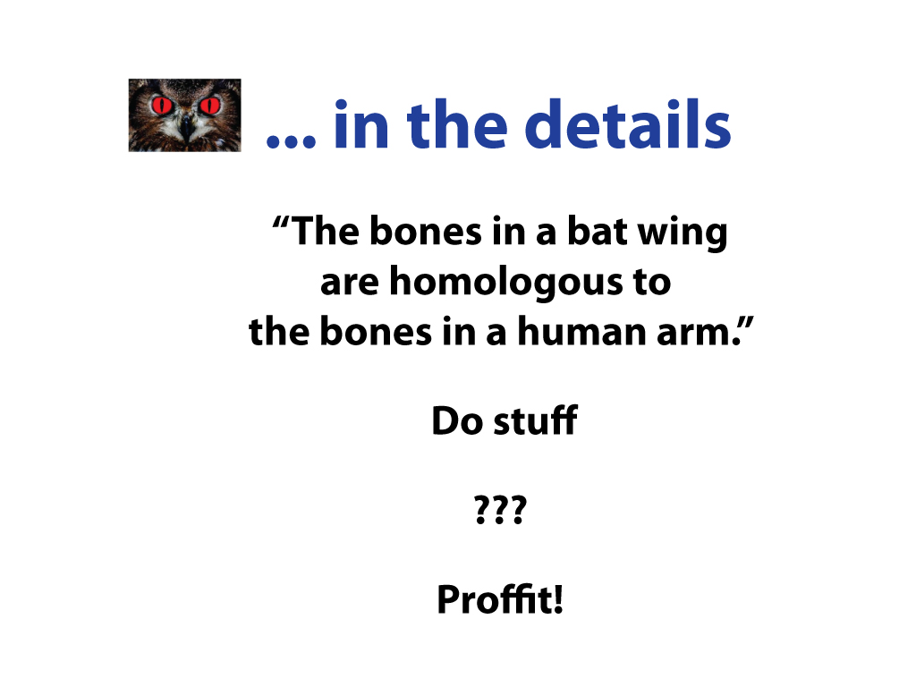

Slide 5
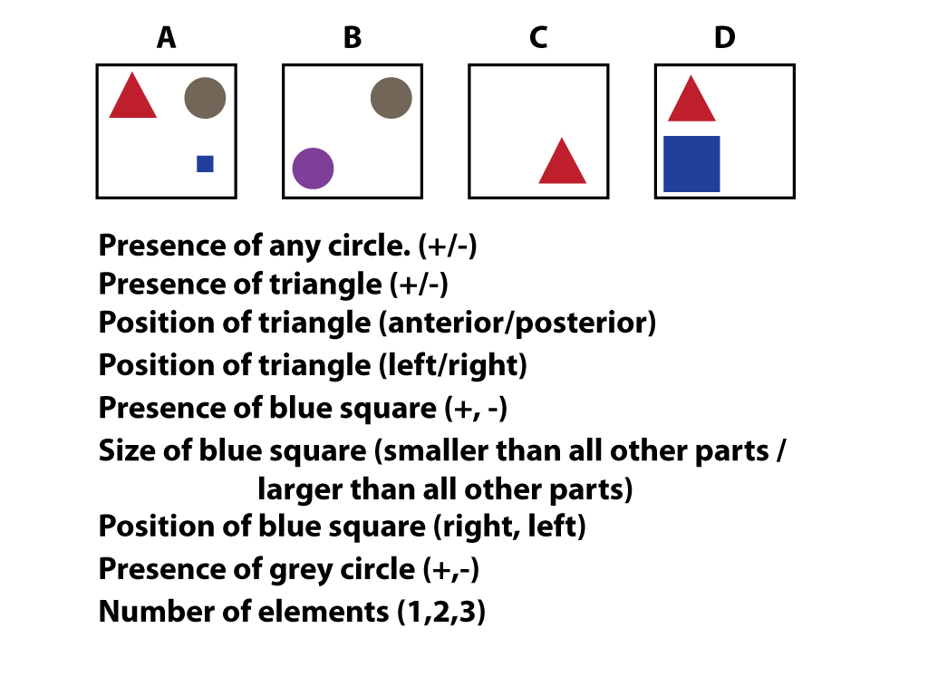

Slide 6
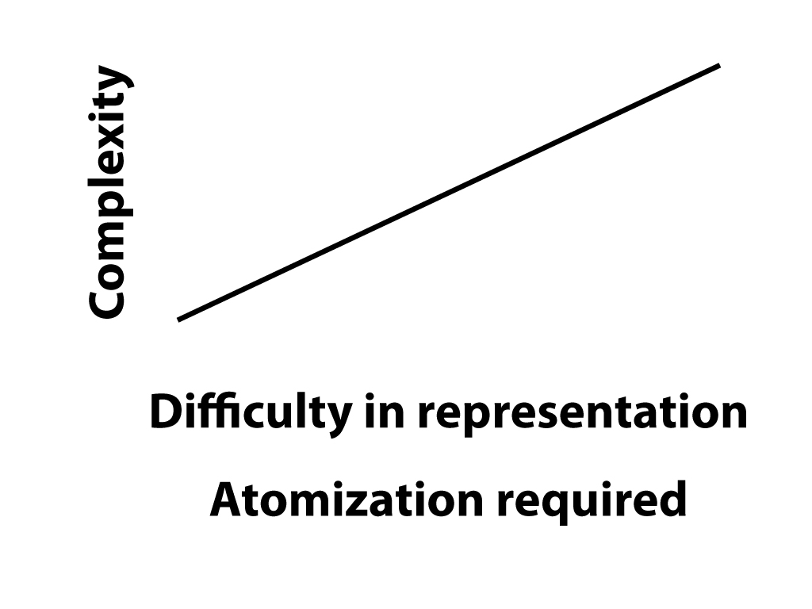

Slide 7
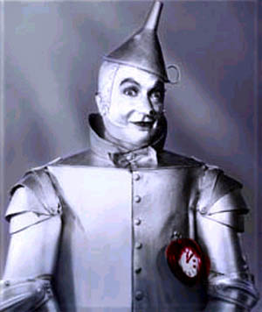
Reasoning across species: querying for genes in similar structures
Vertebrate chambered heart
Process Conserved genes
Specification tinman/nkx2.5, wnts
A-P patterning Hox genes, RA
Morphogenesis Seven-up/Couptf-II
Uberon has a heart.
Uberon heart: A hollow, muscular organ, which, by contracting rhythmically, keeps up the circulation of the blood. [GO:0007507]
Xrefs to FBbt, ZFA, FMA, etc.
Arthropod dorsal vessel
Xavier-Neto et al., Cell Mol Life Sci, 2007
Genetic mechanisms may be reused in analogous structures
Structures may be homologous in ways that are yet undetermined
Notes:
Dorsal vessel/vertebrate chambered heart homology is controversial, discuss how homology may not be known and how two homologous structures may not have homologous parts or vice versa.

Slide 8
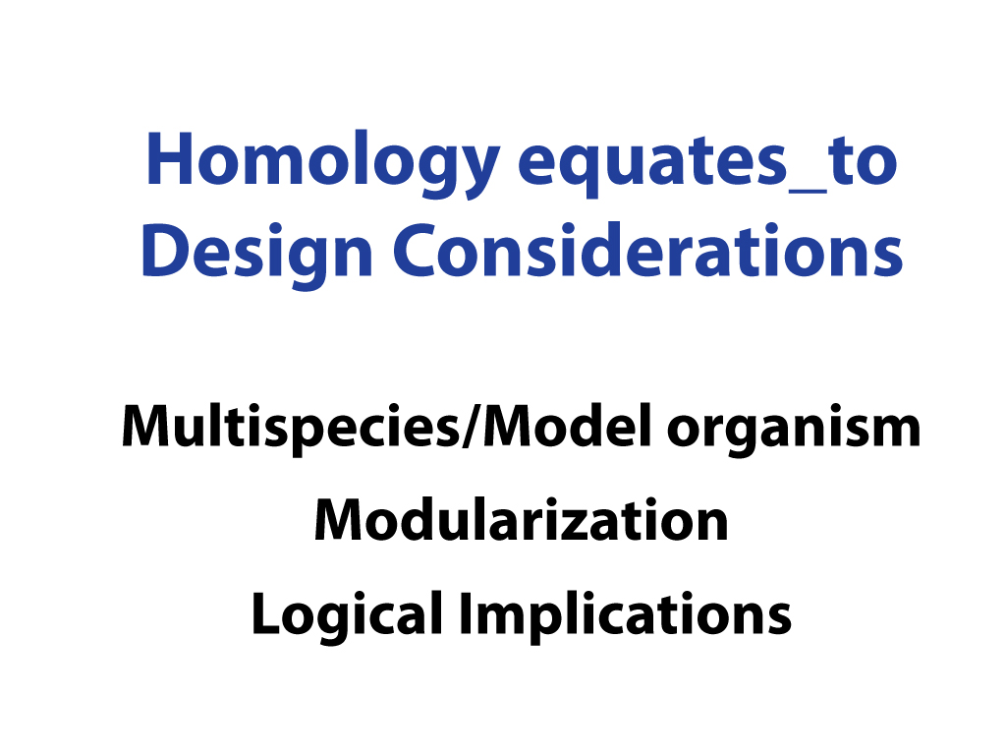

Slide 9
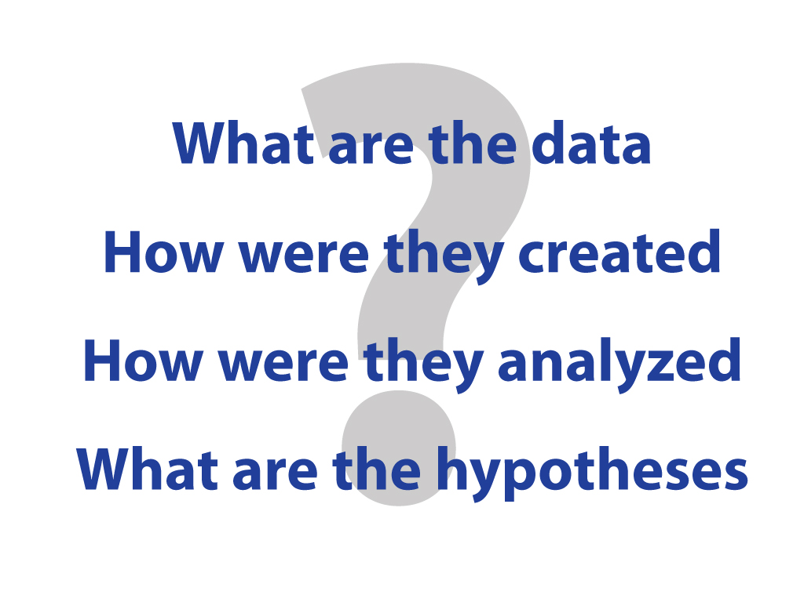

Slide 10
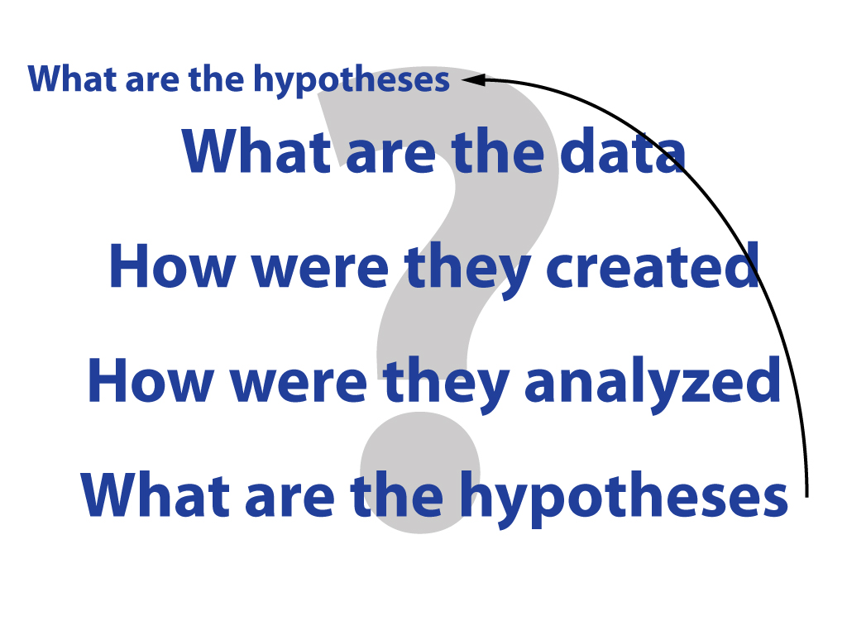

Slide 11
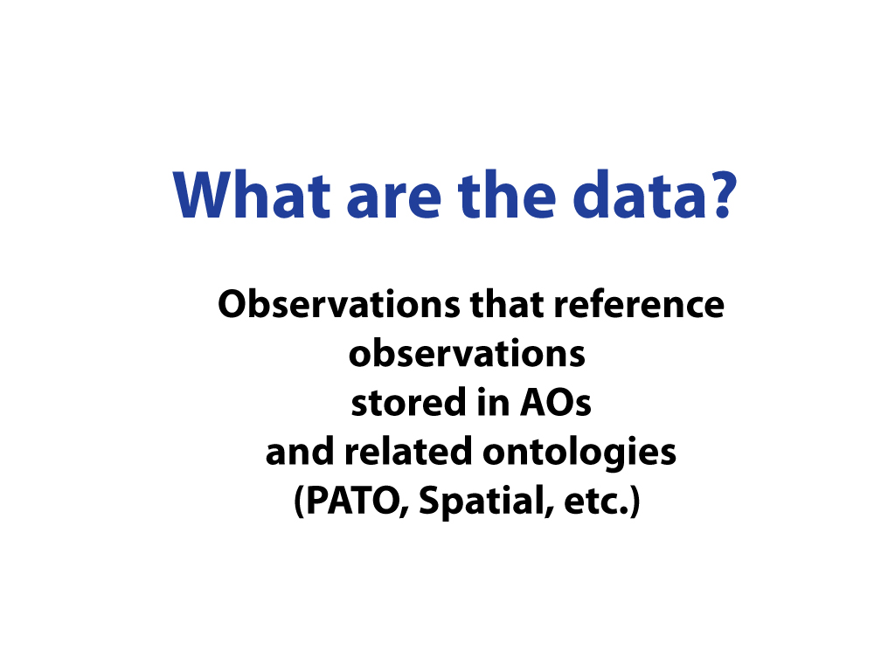

Slide 12
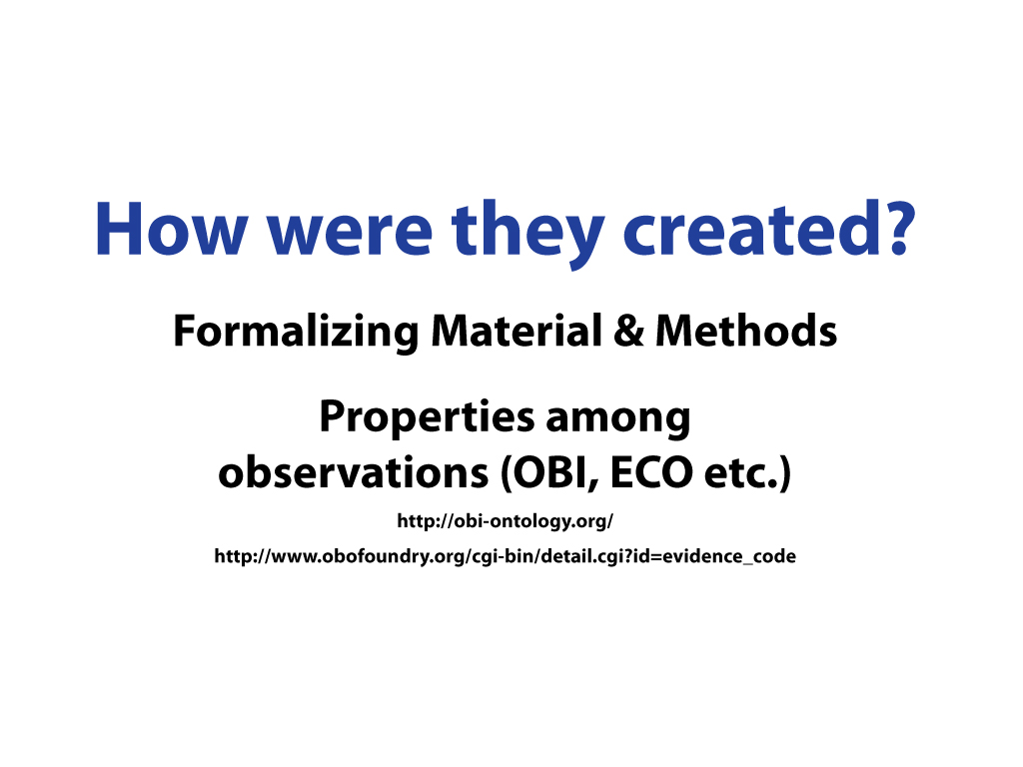

Slide 13
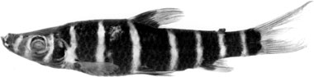
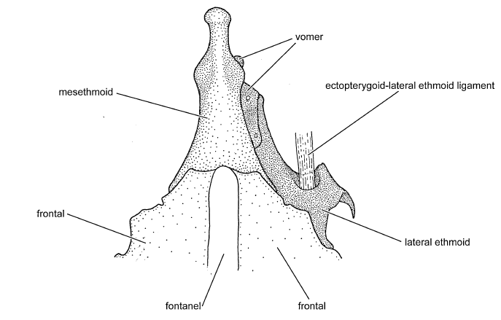
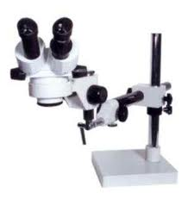
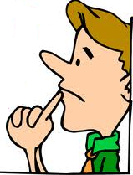
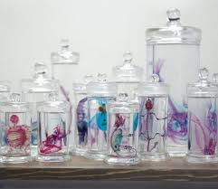
What is evidence?
ECO:000000X
Imaging assay evidence
Synaptolaemus cingulatus
AMNH 91095
Phenotype (character) annotation:
S. Cingulatus: mesethmoid
narrow
OBI:Specimen
Drawing about anatomical entity
OBI:Conclusion
(textual entity)
OBI:Image
material_processing
is_output
is_output
is_input
Draw prepared specimen
OBI:imaging assay
Brian, 2008, maybe in Venezuela
cleared and stained for
cartilage and bone
OBI: Interpreting Data-
phenotypic assessment
is_input
OBI:processed specimen
Sidlauskas and Vari, Zoological Journal of the Linnean Society, 2008, 154, 70–210

Slide 14
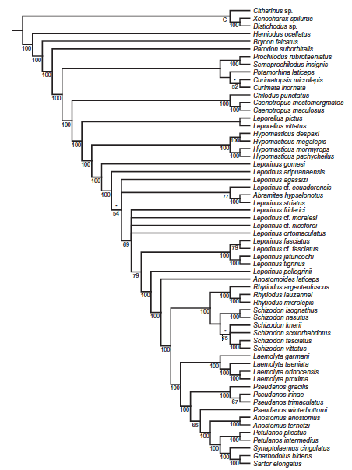
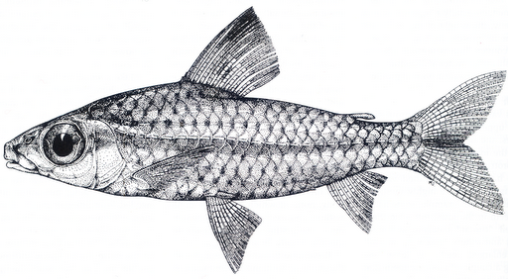
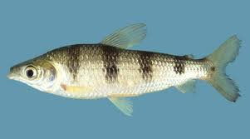
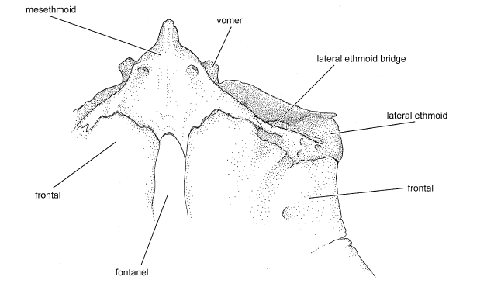
Anatomical evidence is cumulative and synergistic
Synaptolaemus cingulatus
AMNH 91095
mesethmoid
narrow
ECO:0000080
phylogenetic evidence
ECO:0000071
morphological similarity evidence
Caenotropus maculosus
USNM 231545
mesethmoid
narrow
.
is_input
is_output
Schizodon fasciatus
INPA 21606
mesethmoid
wide
.
phylogeny
.
Brian, 2008
.
OBI:Conclusion
Phylogeny construction using PAUP* 4.0 Beta 10
OBI: Interpreting Data

Slide 15
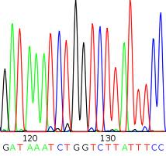
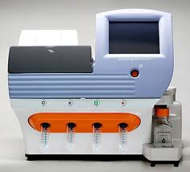
The means to the end matters
Synaptolaemus cingulatus
AMNH 91095
Mesethmoid
ECO:0000080
phylogenetic evidence
ECO:0000071
sequence similarity evidence
Caenotropus maculosus
USNM 231545
mesethmoid
narrow
.
is_input
is_output
Schizodon fasciatus
INPA 21606
mesethmoid
wide
.
phylogeny
.
Brian, 2008
.
OBI:Conclusion
Phylogeny construction using PAUP* 4.0 Beta 10
OBI: Interpreting Data

Slide 16
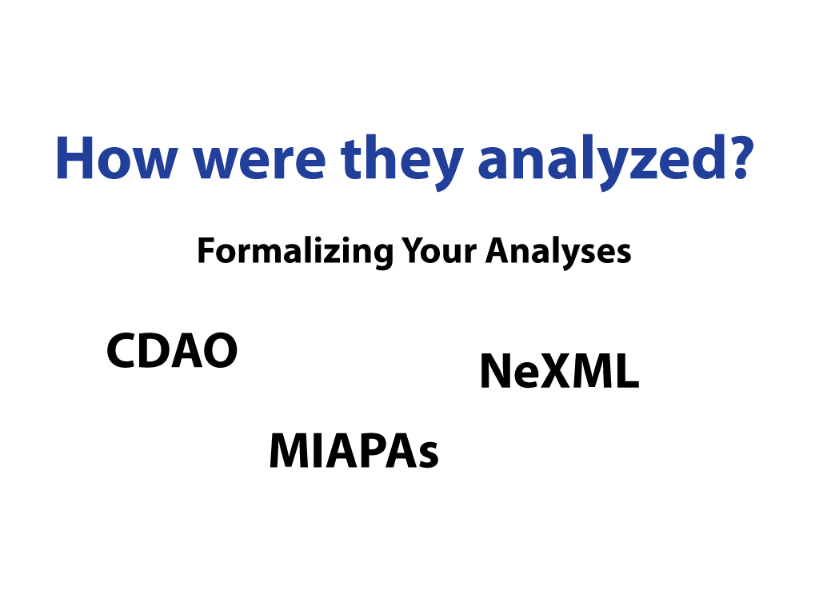

Slide 17
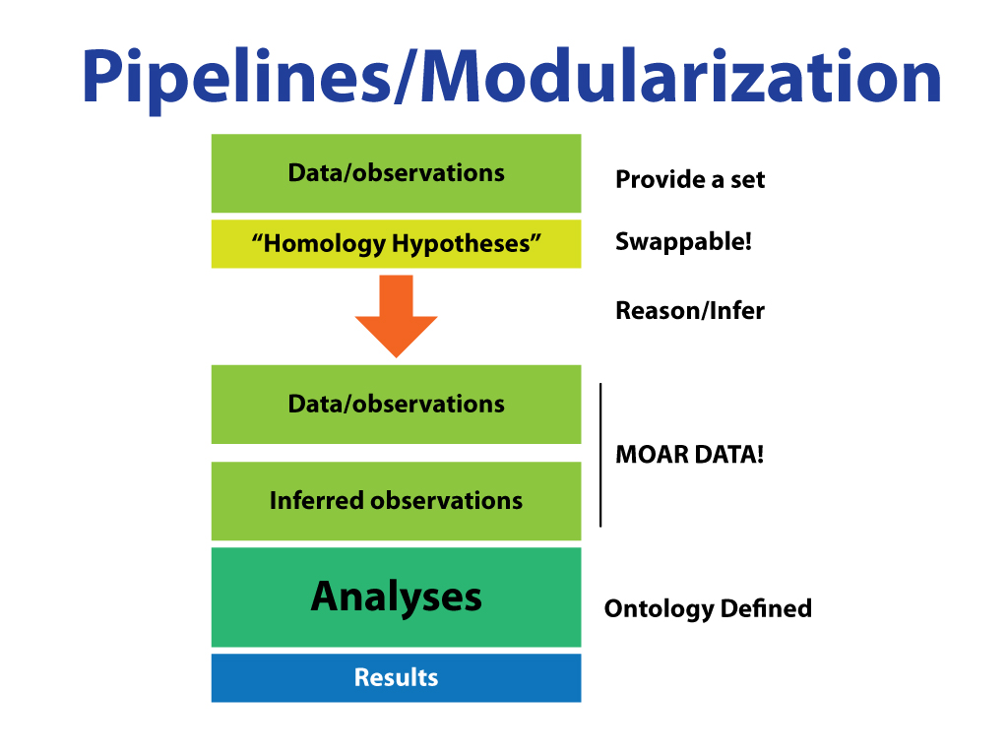

Slide 18
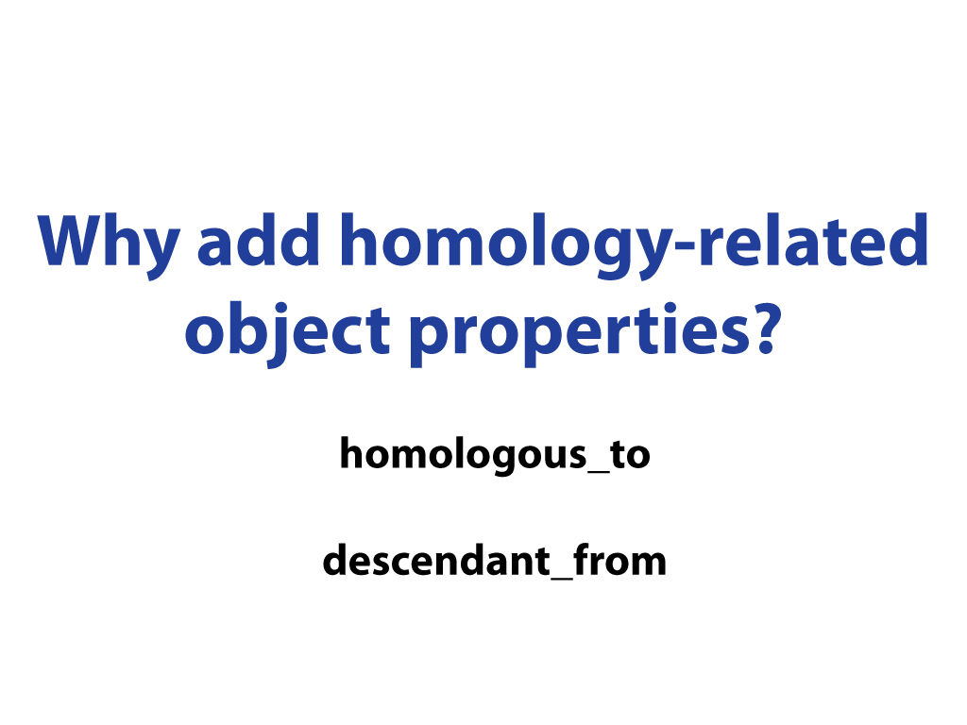

Slide 19
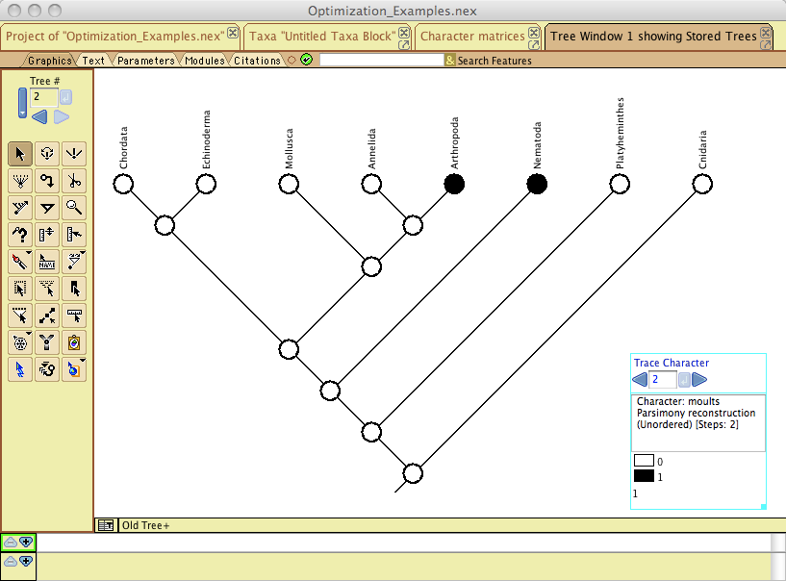
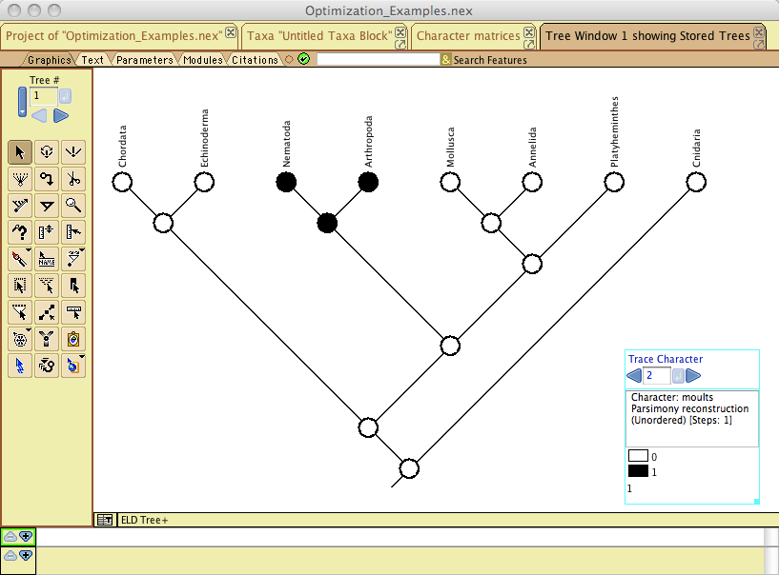
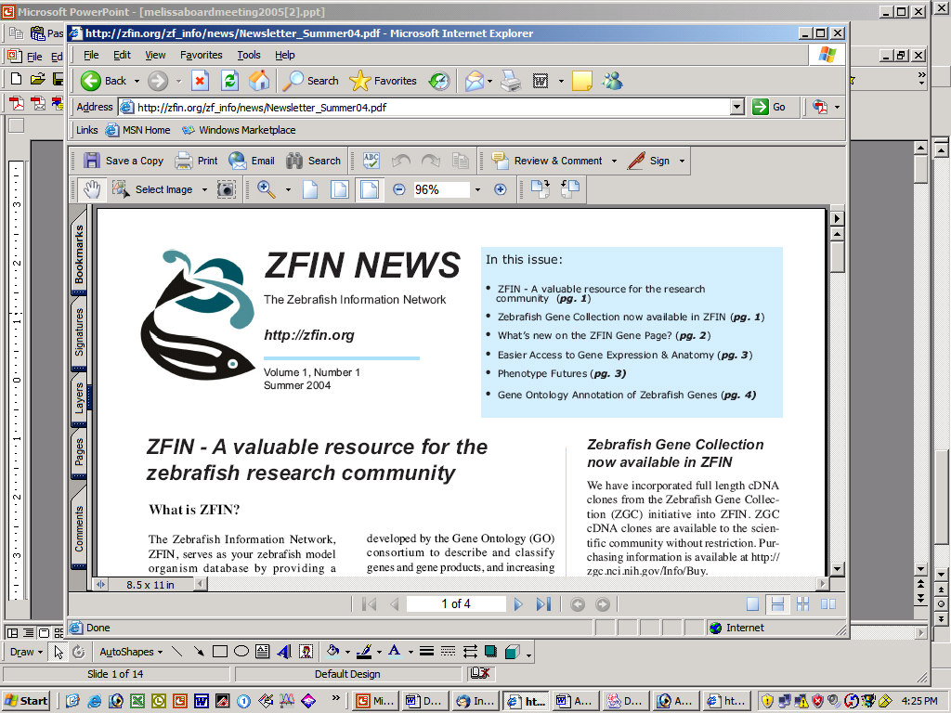
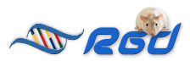
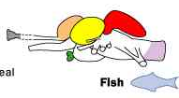
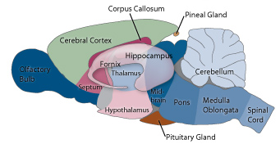
What about homology?
Evolutionary community: Capture multiple homologous_to statements external to Uberon using evidence and attribution. Allows for phylogenetic optimization.
Model organism databases: Use single well-established homologous_to relations between structures in different MODs to create homology links between structures.
ZFIN
Uberon is homology-neutral
Notes:
evo biologists need to do their data-set-specific phylogenetic optimization, but the MODs want to be able to link homologous structures to one another without doing such a thing.

Slide 20
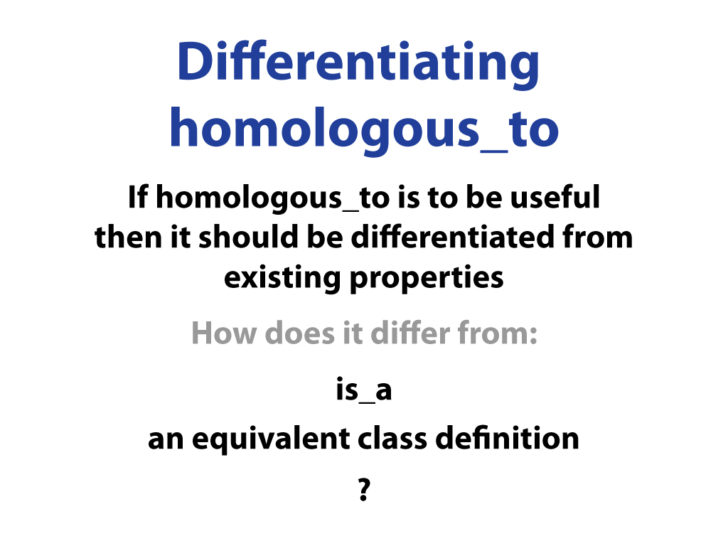

Slide 21
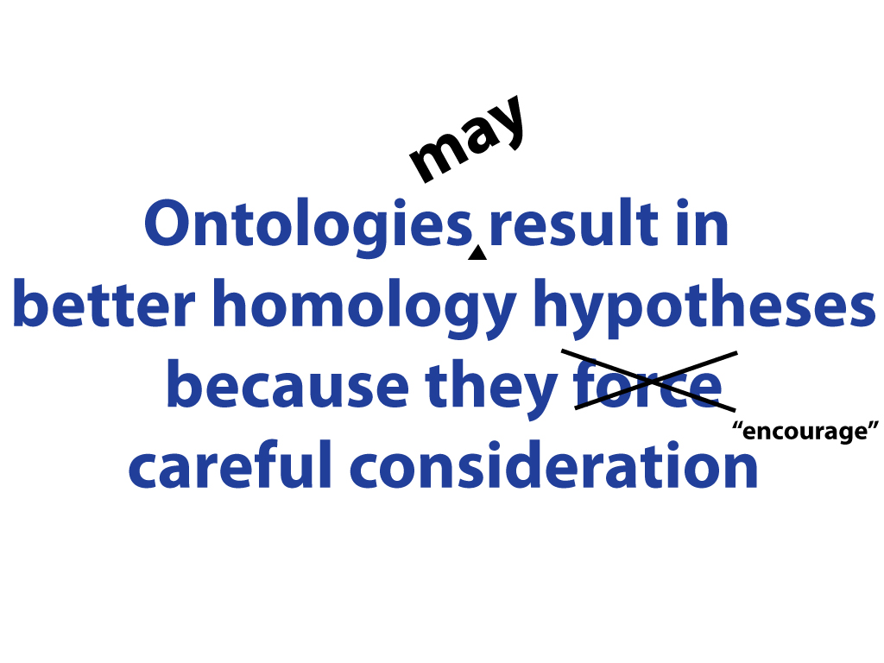

Slide 22
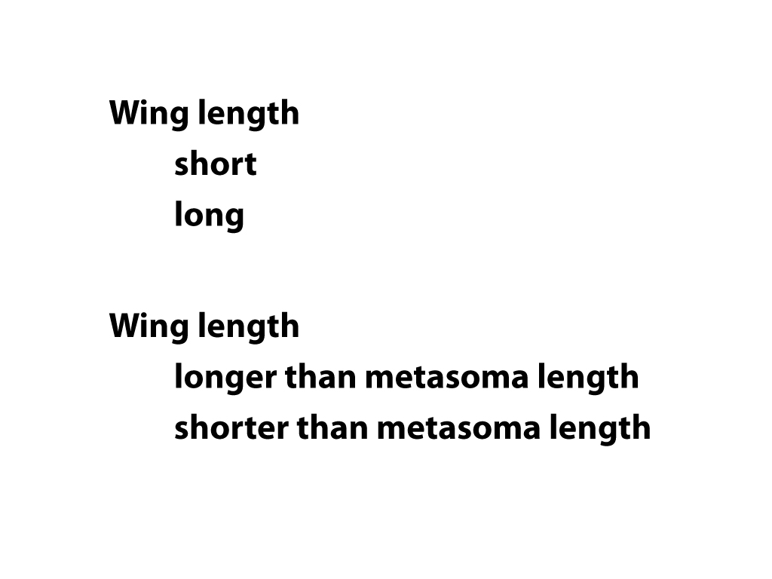

Slide 23
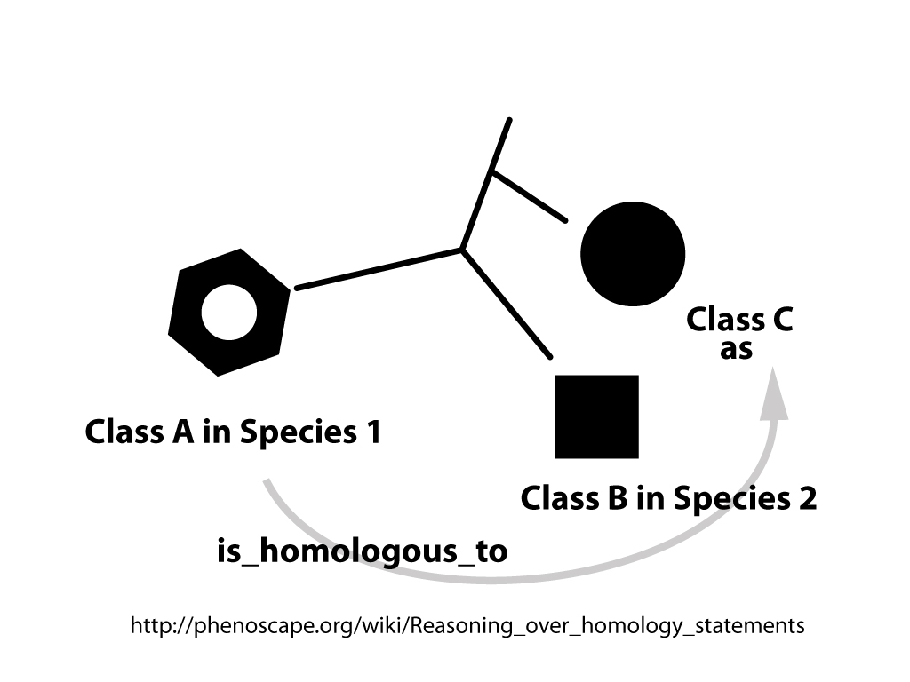

Slide 24
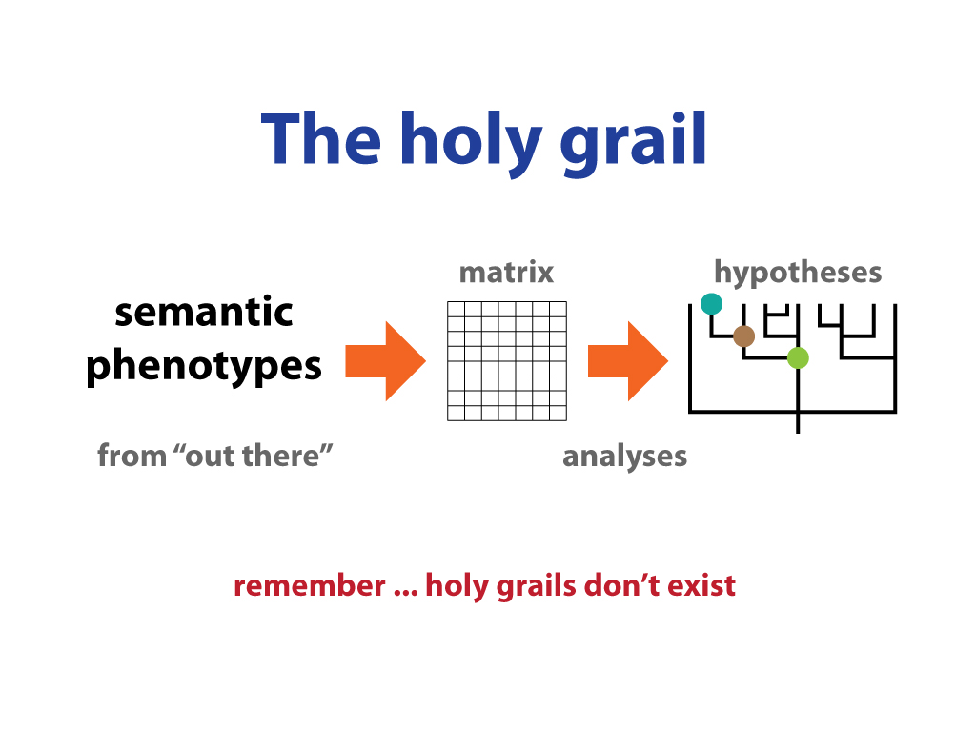

Slide 25
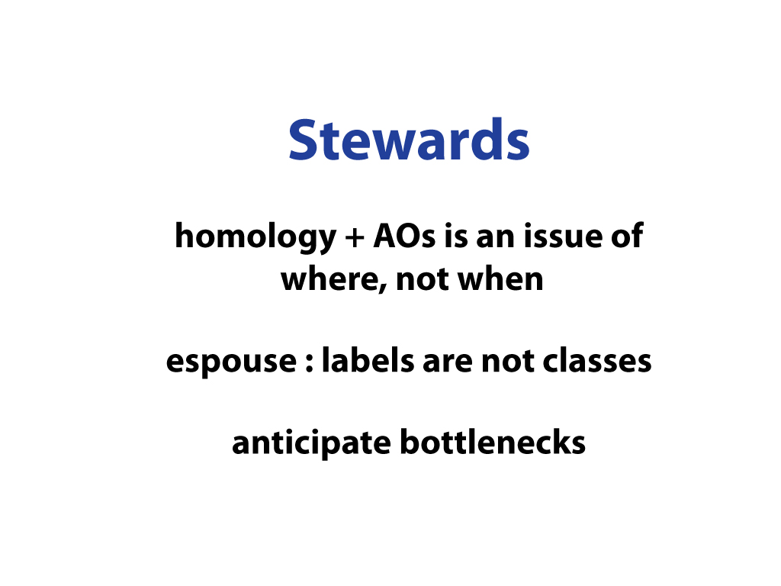

Slide 26
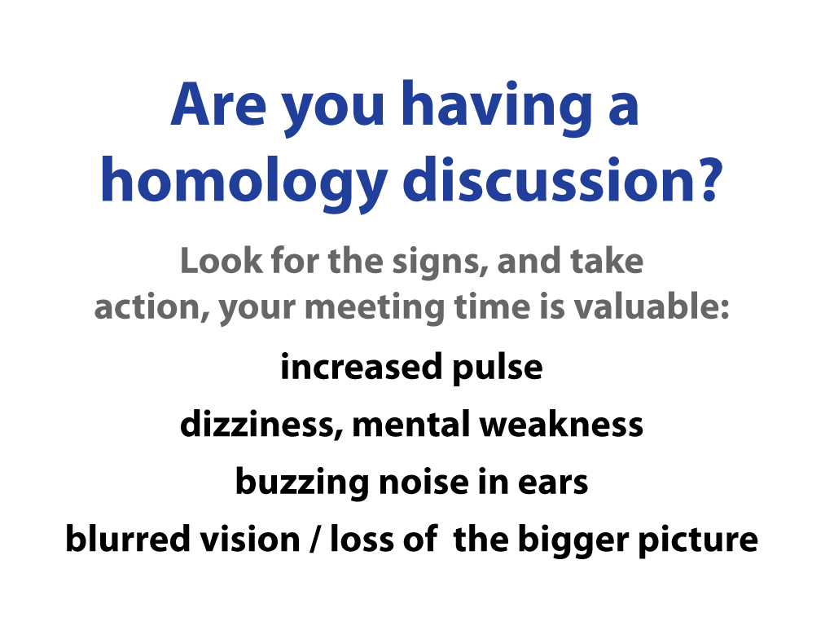

Slide 27
Multispecies anatomy ontologies
Comparing
vHOG (vertebrate Homologous Organs Groups)
http://bgee.unil.ch/bgee/bgee (developers of vHOG)
http://www.berkeleybop.org/ontologies/vhog.owl
VBO (vertebrate bridging Ontology)
Uberon

Slide 30
Uberon and homology
Uberon classes do not need to be homologous
We try to state necessary and sufficient conditions for all classes
Genus: parent class
Differentia may be any mix of:
Locational
Histological
Structural
Functional
Developmental
Or homology!
This is essentially essentialist
‘essentialist’ may make evo-devo folks uncomfortable, but it’s how most ontologies work

Slide 31
Eyes
Eye: organ and has function in go:visual perception
Compound eye: has part ommatidia
Camera-type eye : equivalent to vHOG eye
vertebrate-type*
cephalod-type*
*Not yet in ontology

Slide 32
adrenal gland – interrenal gland
Single class in vHOG
Distinct classes in Uberon
Score highly on semantic similarity measures do to has_part relationships to cell types
Homology can be handled separately
Open question:
interrenal gland vs bodies?
Homology at the level of gland or cortex?

Slide 33
Proposal
Separation of concerns
essentialist definitions
homology relationships
Create ‘homology knowledgebase’
Statements anchored to Uberon classes
E.g
lung (Ubr) has property: homologous, has_evidence …
head kidney + bone marrow, has property: homologous, has_evidence …
Use homology ontology
Contributions from vHOG and Phenoscape
Automatically aggregate for powerful queries

Slide 34
Anatomical evidence: what is it, and why do we care about it?

Slide 35
So what should one do about evidence?
Keep in mind that as you record your phenotype data, the means by which you obtained it can matter later one
Others may want to use your data, and they too will care
You may find that how you know what you know depends on the means to the end
You can work with ECO and OBI to get the terms you need for your work

